Slide 1
COMP257
Predicting Popularity
COMP_Pract_04(Tue 1pm)_Group E
Nikheil Malakar
Gordon Chong Ren Ong
Vo Tuyet Trinh Nguyen
Tracey Truong

Slide 2
What Makes A Song Popular?

Slide 3
Can we predict Popularity for songs?
The predictors are:
acousticness
danceability
duration_ms
energy
instrumentalness
key
liveness
loudness
mode
speechiness
tempo
time_signature
valence
We will analyse these predictors to see if there is any correlation between a song’s audio attribute and it’s associated popularity.

Slide 4
How do we define Popularity?
What is Popularity?
Value between 0 and 100
Popularity is not the total number of tracks
Popularity is the number of plays in a certain period
Duplicate tracks (e.g. the same track from a single and an album) are rated independently.
Artist and album popularity is derived mathematically from track popularity

Slide 5


Slide 6
Approach
The models that we will be using are:
Linear Regression
Logistic Regression
Ridge Regression,Lasso Regression, Elastic Net Regression
Linear SVC
K Neighbour
Recursive Feature Elimination
Tensorflow models

Slide 7
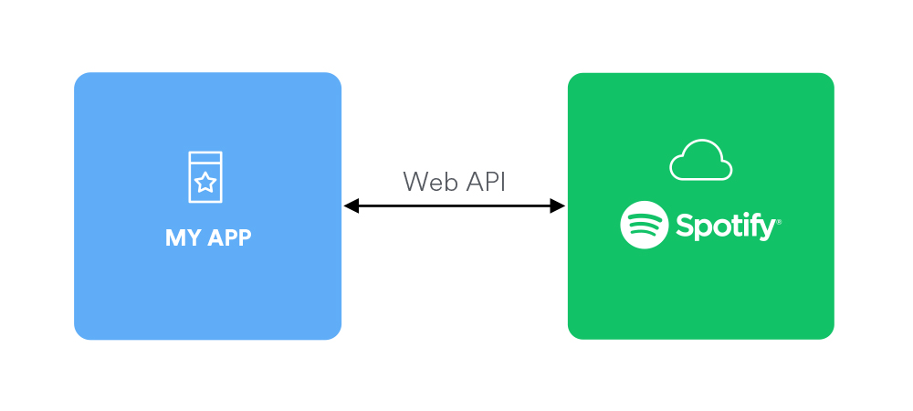
Data Collection
The data collected is through Spotify’s WEB API where a token is necessary.
Get song URIs
Get Spotify developer account
Get token and IDs
Run a GET request from Python
Collect Text data
Clean Text data to List
Get key values

Slide 8
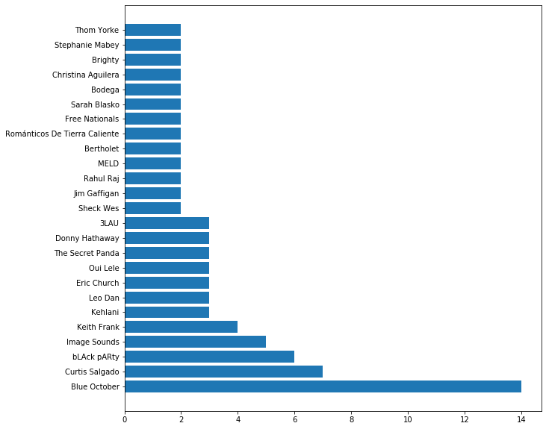
Top Artists

Slide 9
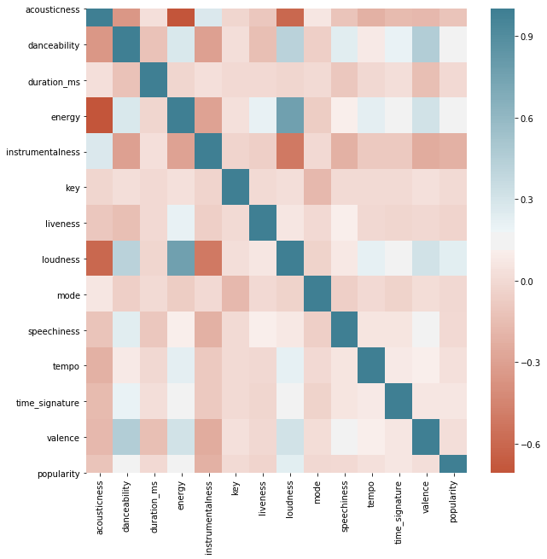
Heatmaps

Slide 10
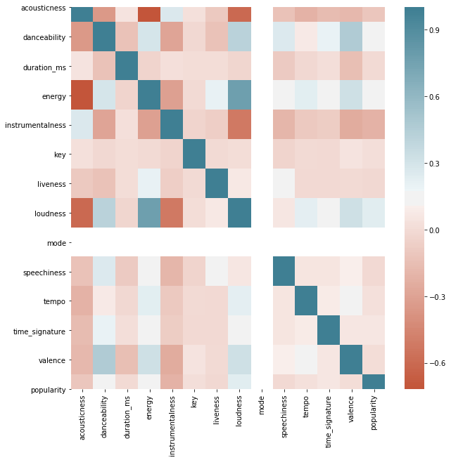
Heatmap
Mayores

Slide 11
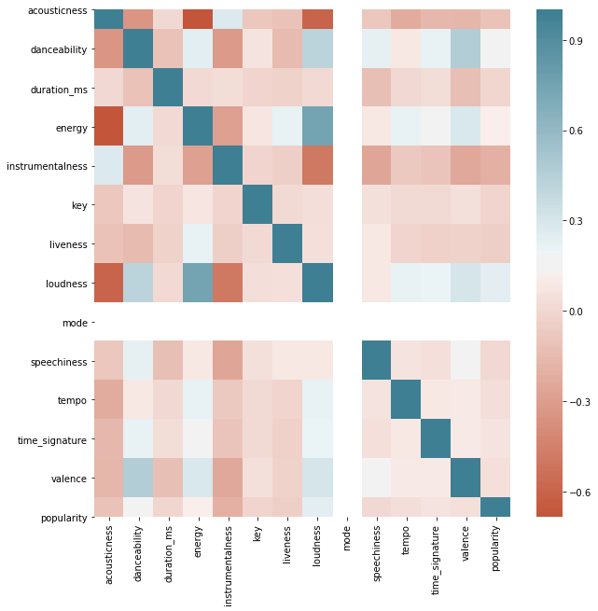
Heatmap
Menores

Slide 12
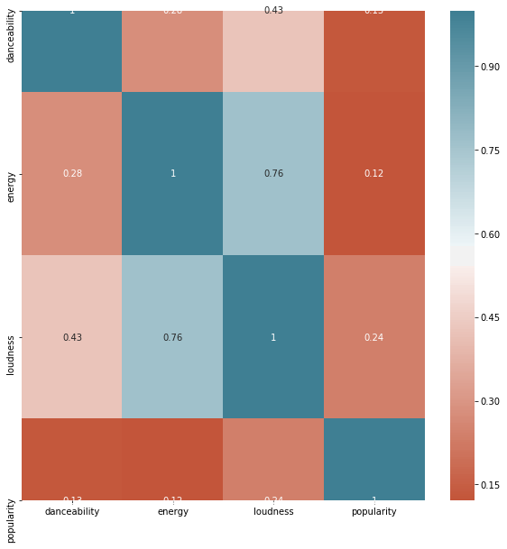
Heatmap

Slide 13
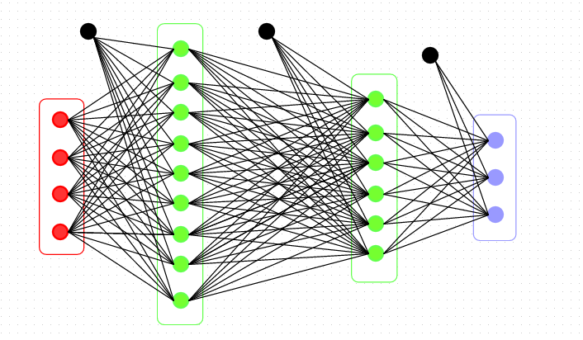

Dense Model vs Classification Model
Dense Model
Last node has one output which will output the Percentage Value.
Classification Model
The last nodes have each value which represents the percentage of the answer.

Slide 14
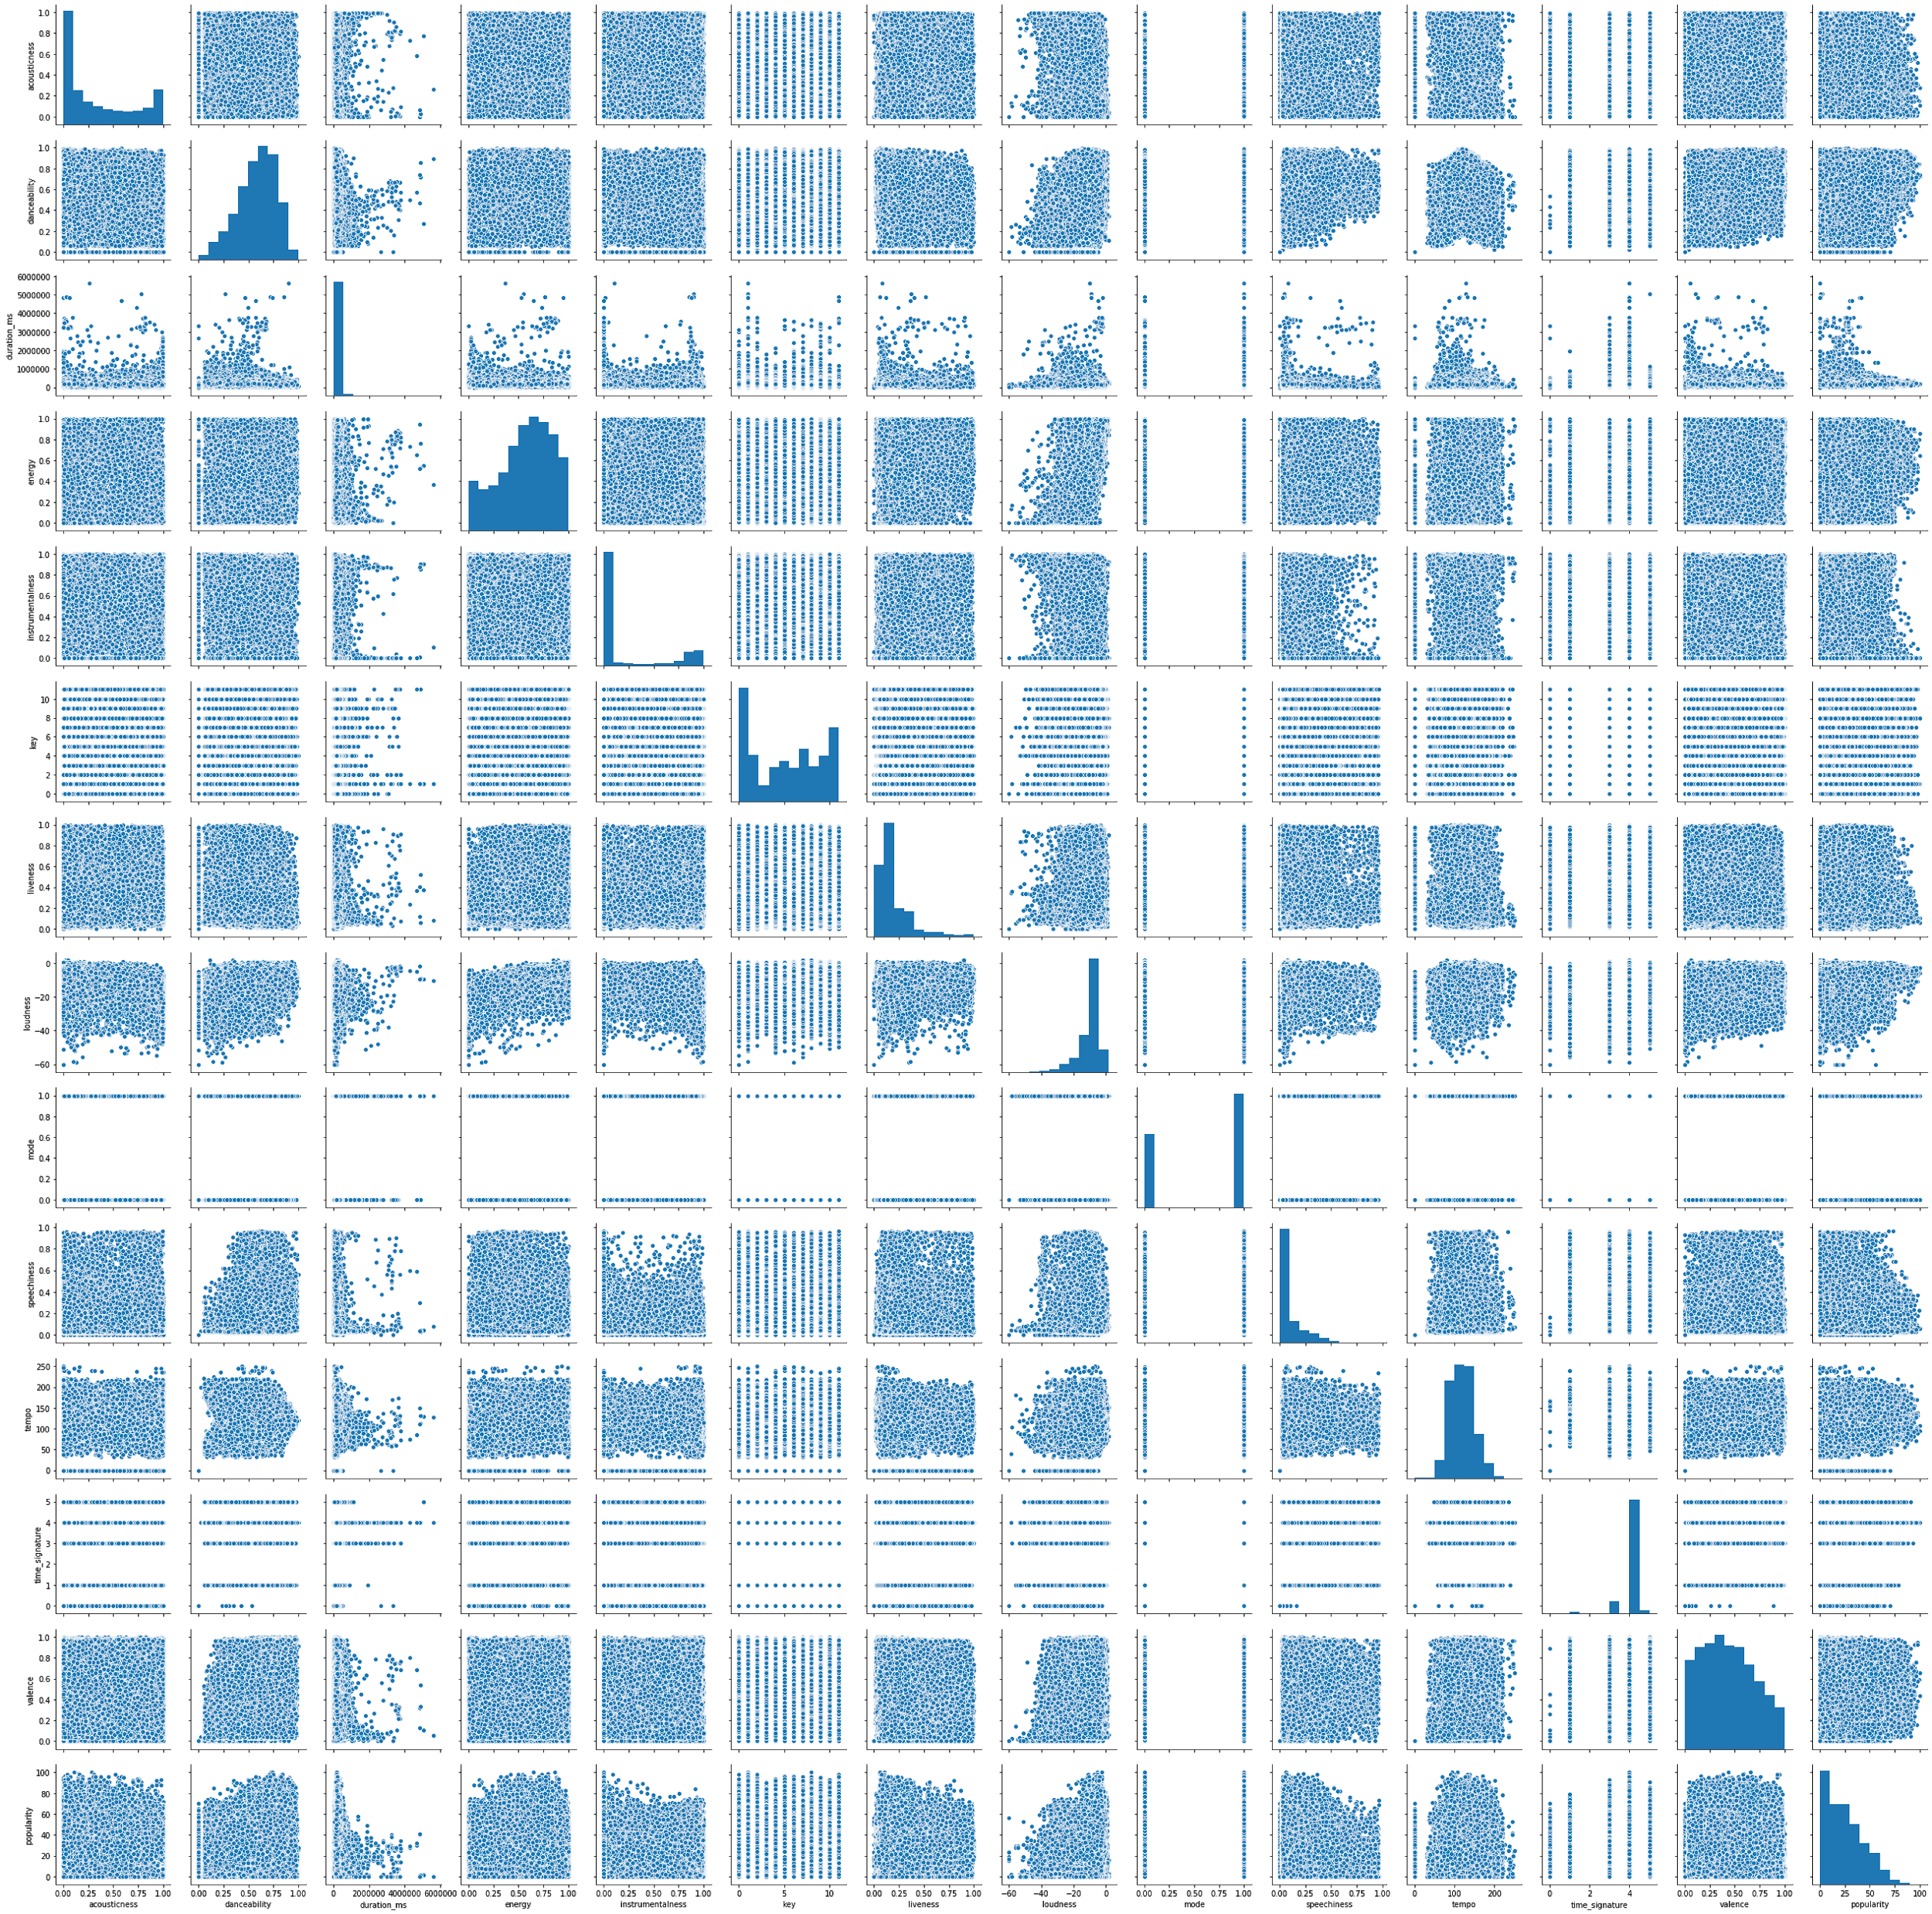
Pairplot
From the scatterplot we can see that there aren’t obvious relationships between any predictors and Popularity.
The distribution of each variable is skewed.

Slide 15
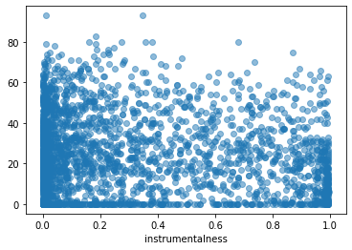
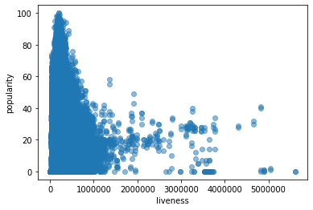
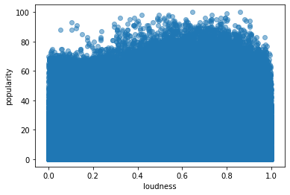
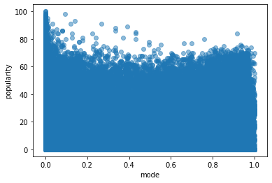
Plotting Popularity vs Predictors

Slide 16
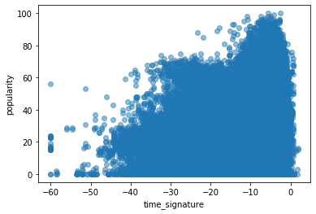
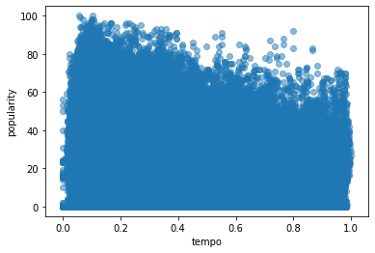
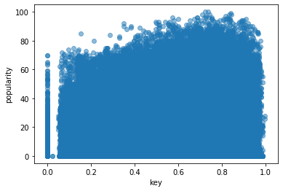
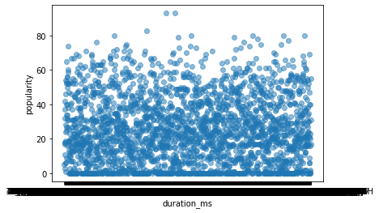
Plotting Popularity vs Predictors

Slide 17

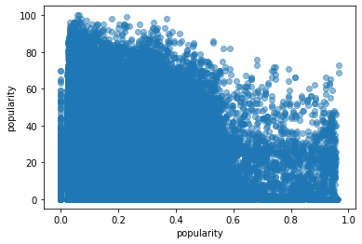
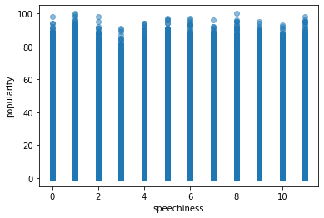
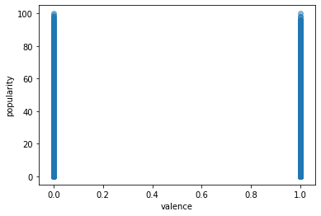
Plotting Popularity vs Predictors

Slide 18
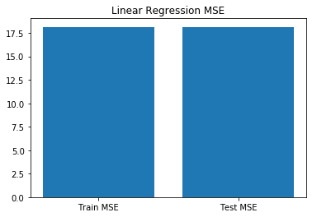
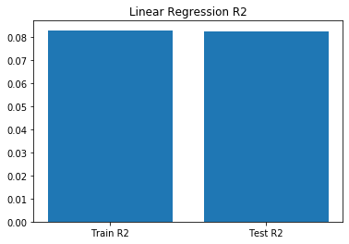
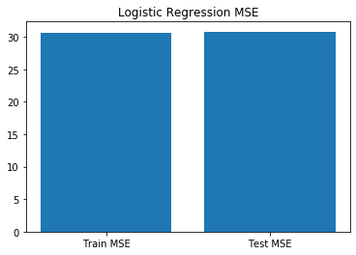
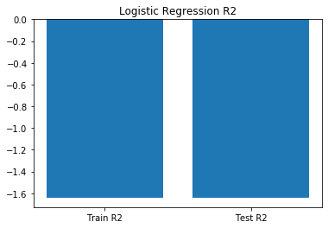
Results of Linear, Logistic, Ridge, Lasso, Elastic Regression models

Slide 19
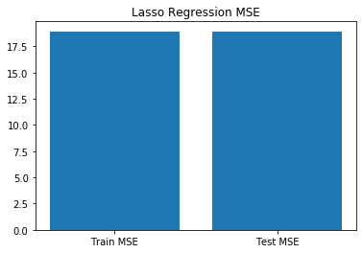
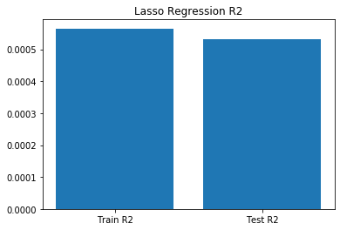
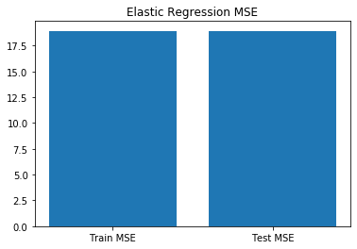
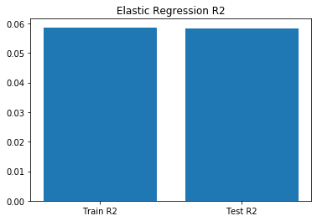
Results of Linear, Logistic, Ridge, Lasso, Elastic Regression models

Slide 20
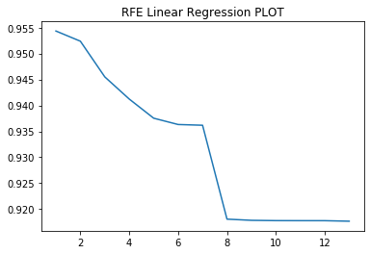
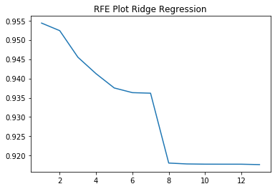
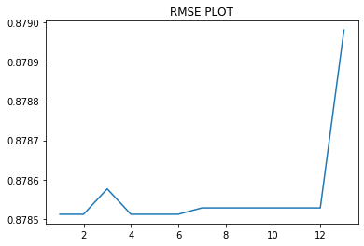
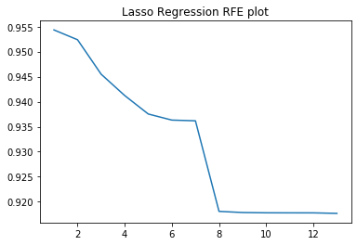
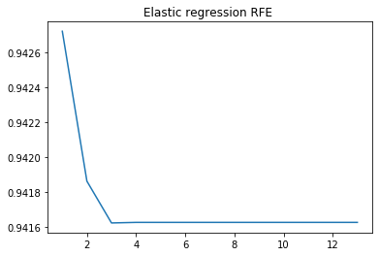
Recursive Feature Elimination Score for Linear, Logistic, Ridge, Lasso,Elastic regression
logistic Regression

Slide 21
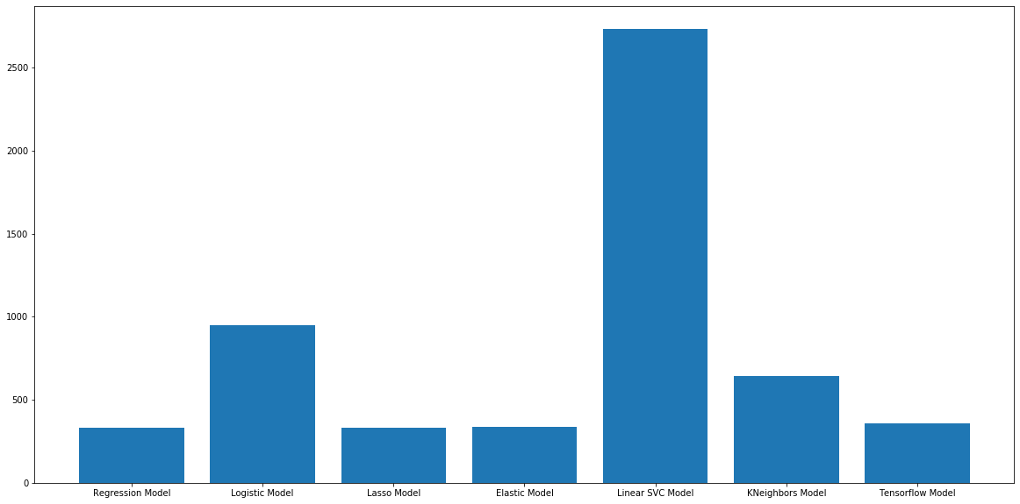
All Model’s Mean Squared Error

Slide 22
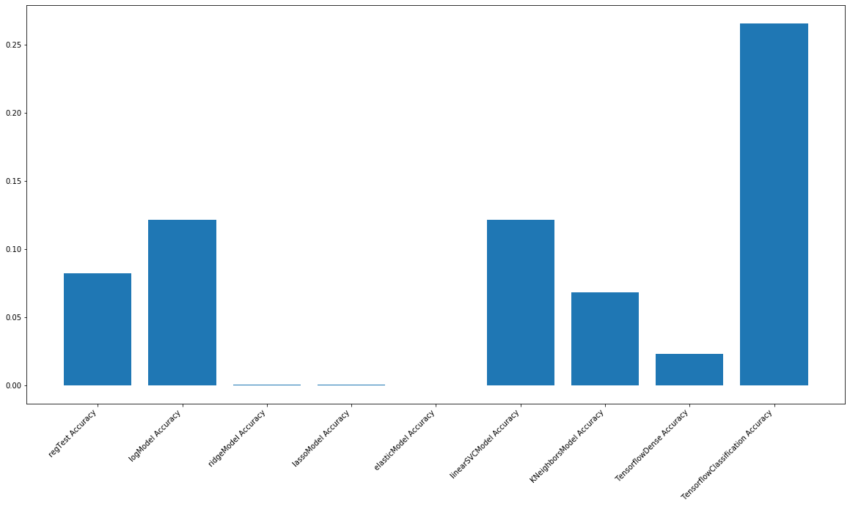
All Model’s Accuracy

Slide 23
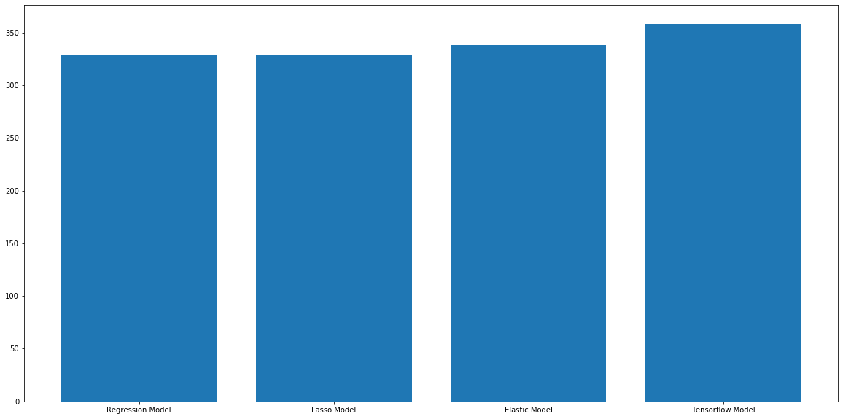
Top 4 Model’s MSE

Slide 24
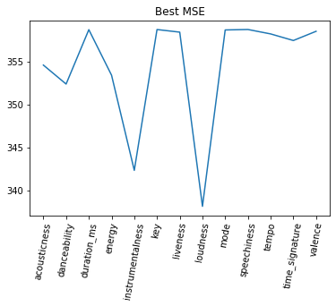
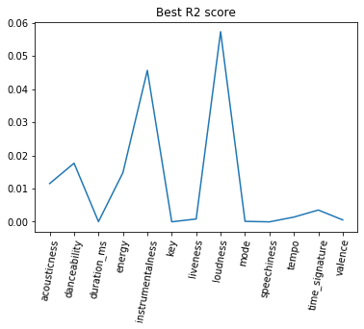
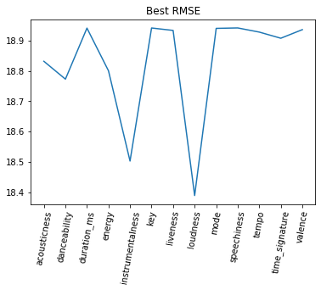
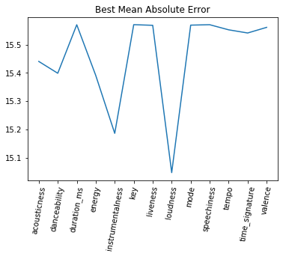
Linear regression on each predictor

Slide 25
Why do we use Categorical Dataset?
We use Categorical Dataset:
To improve accuracy of the model
The prediction by the model can roughly tell where the popularity is going to lie
0-10, 10-20, …, 90-100 has only 10 possible values but
0-100 has 100 possible values
making the models more accurate

Slide 26
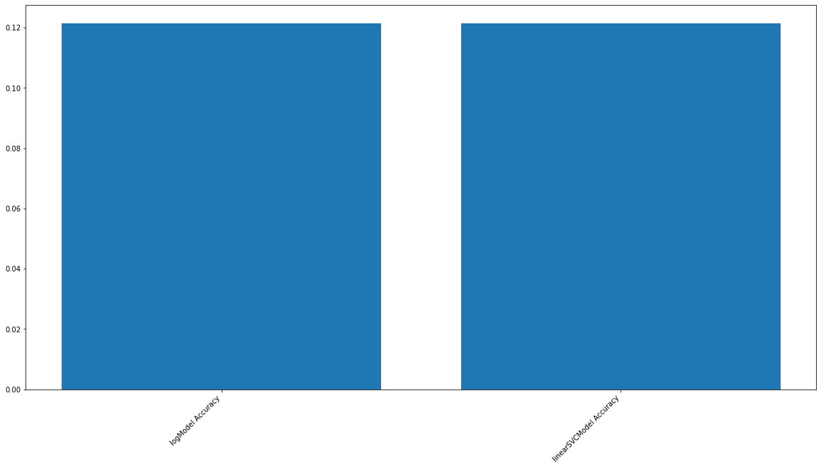
Classification results

Slide 27
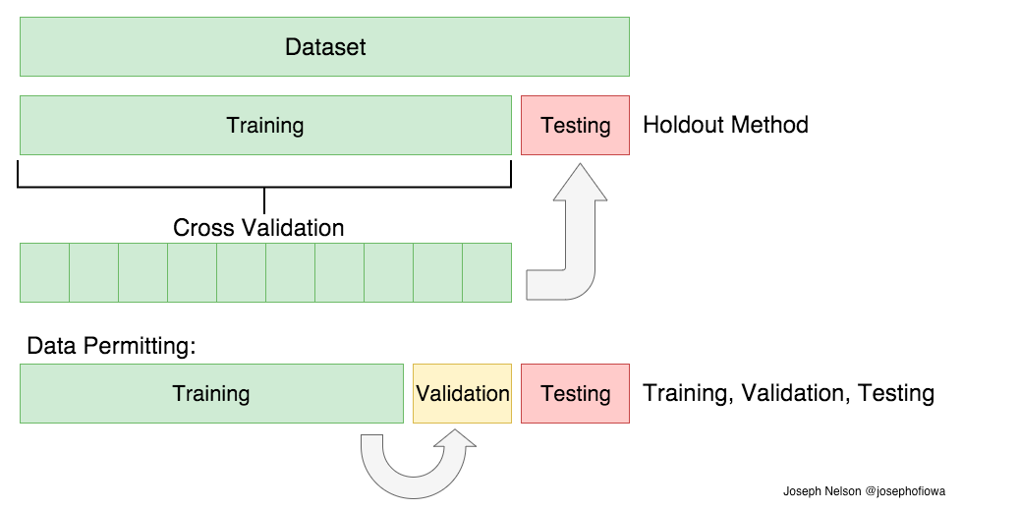
Cross Validation- Linear Regression
What is Cross Validation?

Slide 28
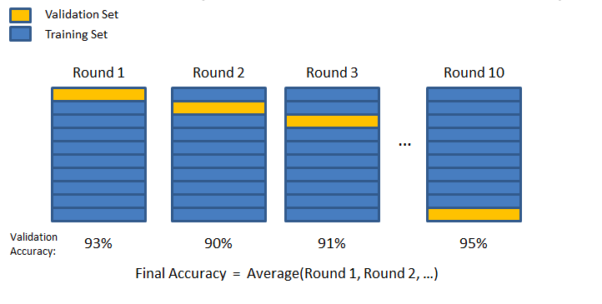

Slide 29
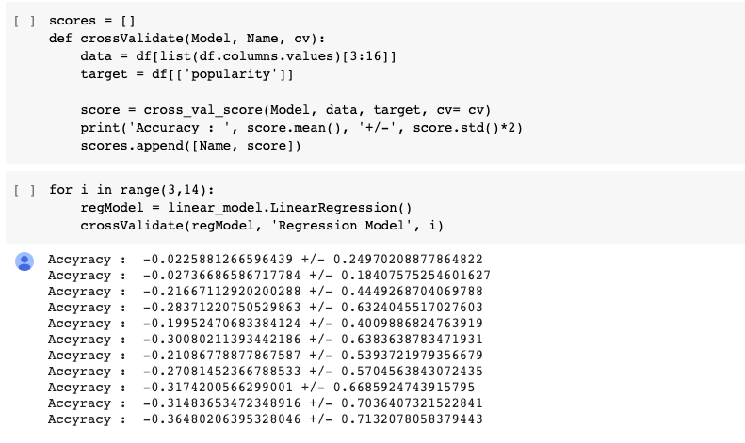

Slide 30
Can we really predict Popularity?
The best predictor for popularity is loudness and instrumentals
The best model is Linear Regression.
As the R2 score is low the accuracy of predicting popularity will be poor
--> Popularity is difficult to predict based on the data.

Slide 31
Future Improvements/Progressions
Transform the variables by using log. This will help with fitting a better linear regression model.
The predictive algorithms could be improved
Taking recent album releases when creating predictions
Observing social media activity pertaining to specific artists

Slide 32
Thank You

